Slide 1

21ECC301P - MICROPROCESSOR, MICROCONTROLLER, AND INTERFACING TECHNIQUES
REVIEW - 1
Design and Implementation of an Autonomous Mobile
STM32-Based System for Spatial Digital Communication
Analysis and Signal Fault Localization
1. Shreevatsa Yeelarthi Reg. No:RA2411067010016
2. Utkarsh Vaibhav. Reg No. :RA2411067010004
3. Syed Adil. Reg No.:RA2411067010024

Slide 2
21ECC301P - MICROPROCESSOR, MICROCONTROLLER, AND INTERFACING TECHNIQUES
PRESENTATION OUTLINE
S.No | Title
1 | Abstract
2 | Objectives
3 | Motivation
4 | Literature Survey
5 | Research Gap
6 | Proposed System
7 | Block Diagram
8 | Hardware & Software Requirements
9 | Result and Discussion
10 | Conclusion
11 | References
2

Slide 3
21ECC301P - MICROPROCESSOR, MICROCONTROLLER, AND INTERFACING TECHNIQUES
ABSTRACT
Digital communication systems such as UART, SPI, I2C, RS485, Wi-Fi, Bluetooth, and LoRa are widely used in embedded and IoT applications, but their performance varies with distance, obstacles, electrical noise, wiring quality, and environment.
Conventional logic analyzers display digital waveforms but are stationary and cannot show how communication quality changes across a physical space.
This project proposes an autonomous mobile embedded platform — a differential-drive rover fitted with an STM32-based logic analyzer, wireless modules, encoders, an IMU, and distance sensors — for spatial communication analysis.
The rover collects digital and wireless measurements at multiple locations, transfers them to a Python application, and generates a spatial signal-quality map, extending a conventional logic analyzer into a mobile cyber-physical system.
3

Slide 4
21ECC301P - MICROPROCESSOR, MICROCONTROLLER, AND INTERFACING TECHNIQUES
OBJECTIVES
Design a small autonomous differential-drive rover.
Integrate the existing STM32 digital logic analyzer into the rover.
Capture UART, GPIO, PWM, and selected serial signals.
Measure wireless signal strength via Wi-Fi, Bluetooth, or LoRa.
Record packet loss, latency, and communication errors.
4

Slide 5
21ECC301P - MICROPROCESSOR, MICROCONTROLLER, AND INTERFACING TECHNIQUES
MOTIVATION
A signal may look correct at one test point yet become unreliable elsewhere due to distance, electromagnetic interference, obstacles, poor wiring, or timing issues — a limitation of any fixed-point logic analyzer.
Communication faults in embedded and IoT systems are often location-dependent, and manual measurement is slow and produces inconsistent results since position must be recorded separately.
There is a need for a low-cost mobile system that can move autonomously, record its position, measure communication quality, and present the results as a visual spatial map.
The aim is an autonomous mobile STM32-based platform that combines digital logic analysis, wireless signal monitoring, and rover navigation to identify and map communication faults in a physical environment.
5

Slide 6
21ECC301P - MICROPROCESSOR, MICROCONTROLLER, AND INTERFACING TECHNIQUES
LITERATURE SURVEY
Sl.no | Title | Author | Year | Content
1 | WiFi Localization and Navigation for Autonomous Indoor Mobile Robots | J. Biswas, M. Veloso | 2010 | Uses Wi-Fi signal-strength maps with odometry for autonomous indoor robot localization and navigation; directly supports mobile spatial RSSI mapping.
2 | Range-only SLAM with a Mobile Robot and a Wireless Sensor Networks | E. Menegatti et al. | 2009 | Uses RSSI-derived range measurements with EKF-SLAM while a robot moves through a wireless sensor network; addresses noisy indoor radio measurements.
3 | Autonomous Mobile Robot Localization Based on RSSI Measurements Using an RFID Sensor and Neural Network BPANN | N. A. Sabto, K. Al Mutib | 2013 | Mounts an RFID receiver on a mobile robot and uses RSSI measurements with a neural network to estimate location from wireless landmarks.
4 | RSSI-based Relative Localisation for Mobile Robots | L. Oliveira et al. | 2013 | Demonstrates relative localization and velocity estimation for mobile robots using RSSI exchanged between wireless nodes.
6

Slide 7
21ECC301P - MICROPROCESSOR, MICROCONTROLLER, AND INTERFACING TECHNIQUES
LITERATURE SURVEY (contd.)
Sl.no | Title | Author | Year | Content
5 | Particle Filter Design for Mobile Robot Localization Based on Received Signal Strength Indicator | C.-C. Hsu, S.-S. Yeh, P.-L. Hsu | 2016 | Applies particle filtering to RSSI-based mobile-robot localization and studies errors caused by interference, reflections, and antenna orientation.
6 | Precise and Accurate Wireless Signal Strength Mappings Using Gaussian Processes and Path Loss Models | R. Miyagusuku, A. Yamashita, H. Asama | 2018 | Builds probabilistic wireless signal-strength maps for robot localization by combining path-loss models with Gaussian processes.
7 | Comparing WiFi RSS Filtering for Wireless Robot Location System | M. S. Rahman et al. | 2019 | Compares filtering approaches for noisy Wi-Fi RSS in real-time mobile-robot positioning, including Kalman filtering and weighted fusion.
8 | Model Predictive Control for Wireless Communication Reliability of Mobile Inspection Robots in Substations | W. Sun et al. | 2026 | Studies how distance, obstacles and electromagnetic interference affect RSSI reliability for mobile inspection robots in an industrial environment.
7

Slide 8
21ECC301P - MICROPROCESSOR, MICROCONTROLLER, AND INTERFACING TECHNIQUES
RESEARCH GAP
What the surveyed work provides
Gap this project addresses
[1]–[5] Mobile-robot studies use RSSI/Wi-Fi/RFID for localization and navigation.
[6], [7] Signal-map modeling and filtering improve noisy RSS/RSSI measurements.
[8] Industrial mobile robots face communication variation from distance, obstacles and electromagnetic interference.
Prior work focuses mainly on localization, navigation, or wireless-link reliability—not onboard digital protocol diagnosis.
No low-cost mobile platform combines digital logic capture with spatial wireless-link measurements
Digital protocol faults and wireless quality are rarely logged together at the same physical coordinates
Existing RSSI mapping work does not localize UART/GPIO/PWM timing or framing faults
Opportunity for adaptive re-scanning of weak-signal or high-error zones
Problem statement: no low-cost setup today shows where in a space a digital or wireless link starts to fail. This project puts an STM32 logic analyzer and an ESP32 link monitor on an autonomous rover and maps every position-tagged measurement.
8

Slide 9
21ECC301P - MICROPROCESSOR, MICROCONTROLLER, AND INTERFACING TECHNIQUES
PROPOSED SYSTEM
1
2
3
4
Autonomous Rover
Digital Signal Analysis
Wireless Monitoring
Laptop Visualization
Differential-drive chassis with geared DC motors
TB6612FNG driver controlled by STM32 PWM
Wheel encoders + MPU6050 IMU for odometry and heading
HC-SR04 ultrasonic sensors for obstacle avoidance
STM32 samples GPIO lines using timer + DMA
Edge / pattern trigger detection with buffered capture
UART decoding with baud-rate and framing-error checks
Duty-cycle and timing measurement of PWM signals
ESP32 reads Wi-Fi RSSI at every measurement point
Test packets give packet success / loss and latency
Connection stability logged over the whole scan
Optional LoRa / Bluetooth link tests
Python dashboard receives data over Wi-Fi
Rover path with position-tagged points
Signal-strength and packet-loss heat maps
Waveforms, decoded UART and battery status
Parameters logged at every measurement point
RSSI (dBm)
Packet loss (%)
Latency (ms)
Baud rate
Duty cycle (%)
UART errors
Position (x, y)
Battery level
9

Slide 10
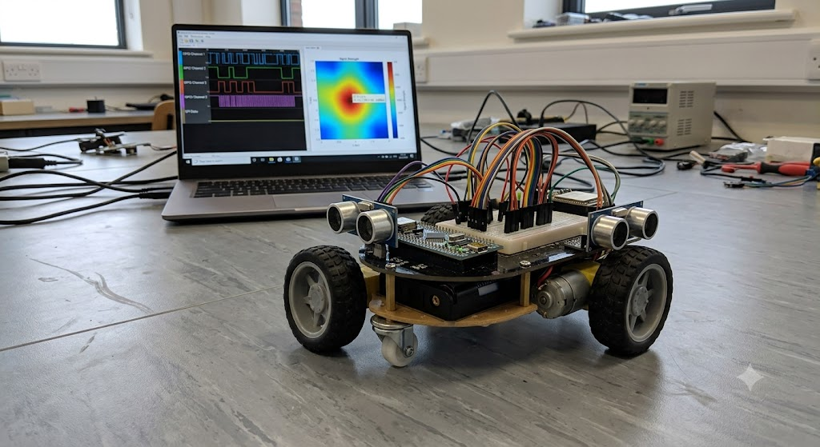
21ECC301P - MICROPROCESSOR, MICROCONTROLLER, AND INTERFACING TECHNIQUES
PROPOSED SYSTEM (contd.)
Operator defines the test area or measurement path; rover starts from a known location.
Rover moves to a measurement point, stops, and records its position.
Wireless subsystem measures signal strength and quality; STM32 analyzer captures the digital signal.
System computes parameters (baud rate, packet loss, duty cycle) and stores/transmits the data.
After the scan, software generates a signal-quality map and highlights abnormal areas; rover may re-scan weak-signal zones.
Prototype rover with logic-analyzer capture and RSSI heat-map display
Navigation stages: Manual → Fixed-path → Autonomous waypoint → Adaptive measurement
10

Slide 11
21ECC301P - MICROPROCESSOR, MICROCONTROLLER, AND INTERFACING TECHNIQUES
BLOCK DIAGRAM
Signal Probe Inputs
UART · GPIO · PWM under test
GPIO · TIM + DMA
STM32F103C8T6
Blue Pill · Cortex-M3 · 72 MHz
Firmware functions
Timer + DMA signal capture
Trigger detection & UART decoding
Odometry + IMU heading estimate
PWM motor control & obstacle stop
Position-tagged data frames to ESP32
ESP32
Wi-Fi 802.11 b/g/n + BLE
RSSI · loss · latency
Laptop
Python dashboard
Heat maps · waveforms
Decoded UART log
UART / SPI
Wi-Fi
MPU6050 IMU
3-axis gyro + 3-axis accel
I2C (SCL, SDA)
SPI
LoRa module (optional)
HC-SR04 Ultrasonic
Obstacle distance, 2–400 cm
Trig / Echo (GPIO)
PWM (TIM)
TB6612FNG
Dual H-bridge motor driver
Left DC motor
Wheel Encoders (L / R)
Quadrature pulses for odometry
A / B · TIM encoder
DIR · STBY (GPIO)
Right DC motor
3.3 V / 5 V
VM (motor supply)
Data / control
Buck regulator
5 V / 3.3 V logic rails
V_BAT
Li-ion battery pack
Main supply (V_BAT)
Wireless link
Power
Fig. 1: System block diagram showing the interface used between each module
11

Slide 12
21ECC301P - MICROPROCESSOR, MICROCONTROLLER, AND INTERFACING TECHNIQUES
PROPOSED INTEGRATION SCHEMATIC
Signal connections and power distribution
Probe header
UART / GPIO / PWM
Input protection / level shift
STM32F103C8T6
Blue Pill
GPIO capture
Timer / DMA
UART
I2C
Encoder inputs
PWM + direction
UART crossover
ESP32
TX / RX
Wi-Fi to Python dashboard
MPU6050
SCL / SDA
I2C + pull-ups to 3.3 V
PWM + control
TB6612FNG
PWMA/B, AIN/BIN, STBY
HC-SR04
TRIG / ECHO
ECHO level shift to 3.3 V
Wheel encoders
Left A/B + right A/B
Four digital pulse inputs
Left motor Right motor
AO1/2 BO1/2
Battery + switch
Motor rail: driver VM
Regulated 5 V: sensor / boards
3.3 V: logic / IMU
Common ground for all modules. Proposed interface schematic. Final pin allocation and component ratings require validation.
12
Notes:
Proposed integration schematic based on the components in the supplied deck. UART crosses STM32 TX to ESP32 RX and STM32 RX to ESP32 TX. Probe and ultrasonic inputs require voltage compatibility checks. Motor voltage and regulator capacity must match the selected modules. Do not connect raw battery voltage to logic supply pins. Exact GPIO allocation is intentionally pending timer/DMA resource planning. Wired probes attach at stationary test points.

Slide 13
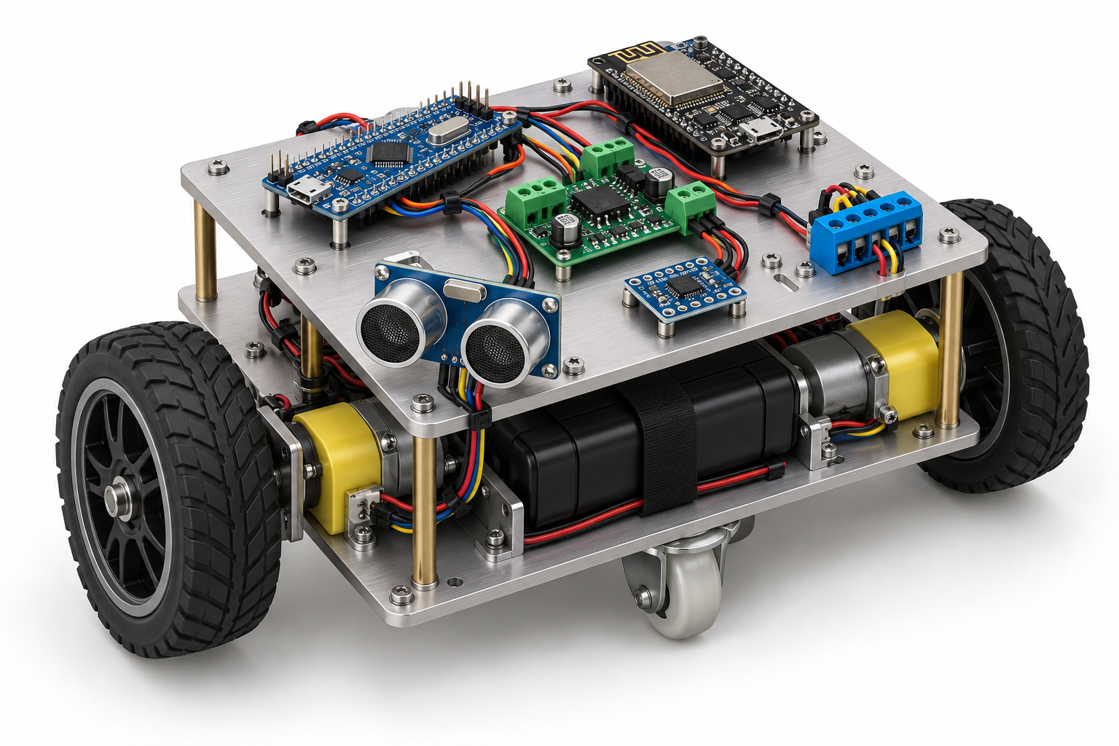
21ECC301P - MICROPROCESSOR, MICROCONTROLLER, AND INTERFACING TECHNIQUES
ROVER 3D CONCEPT MODEL
Proposed component layout
Top deck
STM32 logic analyzer
ESP32 wireless monitor
Motor driver and IMU
Accessible probe connector
Front and lower deck
Ultrasonic obstacle sensor
Battery and geared motors
Encoders and rear caster
AI-generated 3D concept. Module placement is illustrative and dimensions are not finalized.
13
Notes:
AI-generated rendered concept created for this presentation using the built-in image-generation tool. This is a proposed physical layout, not a photograph of a built prototype or dimensioned CAD assembly. Two drive wheels and a rear caster support differential drive. Separate motor power wiring from the signal-probe wiring. Probe inputs measure locally attached wired signals at stopped test locations.

Slide 14
21ECC301P - MICROPROCESSOR, MICROCONTROLLER, AND INTERFACING TECHNIQUES
HARDWARE & SOFTWARE REQUIREMENTS
S.No | Component | Key Specification | Role in Project
1 | STM32F103C8T6 (Blue Pill) | Arm Cortex-M3, 72 MHz, 64 KB Flash, 20 KB SRAM | Logic analyzer and rover controller
2 | ESP32 Wi-Fi + Bluetooth module | Dual-core SoC, 2.4 GHz 802.11 b/g/n, Bluetooth 4.2 / BLE | RSSI, packet-loss and latency tests; data link
3 | MPU6050 IMU | 3-axis gyroscope + 3-axis accelerometer, I2C | Heading and orientation estimation
4 | HC-SR04 ultrasonic sensors | 2 cm – 400 cm range, 40 kHz | Obstacle detection
5 | TB6612FNG motor driver | Dual H-bridge, 1.2 A avg / 3.2 A peak per channel | Drives left and right motors
6 | Geared DC motors with encoders | Quadrature (A/B) wheel encoders | Differential drive and odometry
7 | Li-ion battery pack + buck regulator | Regulated 5 V and 3.3 V rails | Power for motors, MCUs and sensors
8 | LoRa module (optional) | Sub-GHz long-range radio, SPI interface | Long-range link tests
Software & Tools
1
STM32CubeIDE + STM32CubeMX
Embedded C with HAL/LL drivers for timers, DMA, UART and I2C
2
Arduino IDE or ESP-IDF
ESP32 firmware for RSSI scans, test packets and Wi-Fi upload
3
Python 3 (NumPy, Matplotlib)
Laptop dashboard, heat maps and waveform plots
4
PulseView / sigrok (optional)
Reference captures to cross-check decoded signals
Specifications are from manufacturer datasheets; exact motor, encoder and battery ratings will be finalised during hardware selection.
14

Slide 15
21ECC301P - MICROPROCESSOR, MICROCONTROLLER, AND INTERFACING TECHNIQUES
RESULT AND DISCUSSION
Successful autonomous movement of the rover and reliable capture of UART/GPIO signals.
Correct decoding of a UART message such as "HELLO PROFESSOR".
Measurement of wireless signal strength, with detection of packet loss and communication errors.
Generation of a spatial signal-strength heat map identifying weak-signal / high-error areas.
A position-tagged measurement database and a working laptop dashboard for real-time monitoring.
Sample Output
UART CH0: HELLO PROFESSOR
Measurement Location: X = 2.40 m, Y = 1.80 m
RSSI: -72 dBm
Packet Loss: 11.5%
UART Errors: 3
Signal Quality: Poor
Evaluation Parameter | Target
UART decoding accuracy | > 95%
Position error | < 20 cm (short range)
Successful measurement points | At least 20
Rover operating time | At least 20 min
15

Slide 16
21ECC301P - MICROPROCESSOR, MICROCONTROLLER, AND INTERFACING TECHNIQUES
CONCLUSIONS
The proposal presents an autonomous mobile STM32-based system for spatial digital communication analysis and signal fault localization, extending a conventional logic analyzer with a mobile rover, wireless monitoring, position estimation, and laptop-based visualization.
The system addresses a practical engineering problem: identifying how communication quality changes across a physical environment, by pairing signal measurements with rover position to reveal weak-signal areas, packet-loss regions, timing errors, and protocol faults.
The project progresses from a basic logic analyzer to a complete mobile cyber-physical system, with measurable results from comparisons of position accuracy, scanning time, packet-loss detection, signal-map quality, and adaptive measurement performance.
The proposed work is technically feasible using low-cost hardware and existing STM32 knowledge; approval is requested to proceed with design, implementation, testing, and evaluation.
16

Slide 17
21ECC301P - MICROPROCESSOR, MICROCONTROLLER, AND INTERFACING TECHNIQUES
REFERENCES
[1] J. Biswas and M. Veloso, “WiFi Localization and Navigation for Autonomous Indoor Mobile Robots,” Proc. IEEE ICRA, pp. 4379–4384, 2010. doi:10.1109/ROBOT.2010.5509842.
[2] E. Menegatti, A. Zanella, S. Zilli, F. Zorzi, and E. Pagello, “Range-only SLAM with a Mobile Robot and a Wireless Sensor Networks,” Proc. IEEE ICRA, pp. 1699–1705, 2009. doi:10.1109/ROBOT.2009.5152449.
[3] N. A. Sabto and K. Al Mutib, “Autonomous mobile robot localization based on RSSI measurements using an RFID sensor and neural network BPANN,” J. King Saud Univ.–Comput. Inf. Sci., vol. 25, no. 2, pp. 137–143, 2013. doi:10.1016/j.jksuci.2012.10.001.
[4] L. Oliveira, H. Li, L. Almeida, and T. E. Abrudan, “RSSI-based relative localisation for mobile robots,” Ad Hoc Networks, 2013. doi:10.1016/j.adhoc.2013.07.007.
[5] C.-C. Hsu, S.-S. Yeh, and P.-L. Hsu, “Particle filter design for mobile robot localization based on received signal strength indicator,” Trans. Inst. Meas. Control, vol. 38, no. 11, 2016. doi:10.1177/0142331215586615.
[6] R. Miyagusuku, A. Yamashita, and H. Asama, “Precise and accurate wireless signal strength mappings using Gaussian processes and path loss models,” Robotics and Autonomous Systems, vol. 103, pp. 134–150, 2018. doi:10.1016/j.robot.2018.02.011.
[7] “Comparing WiFi RSS Filtering for Wireless Robot Location System,” Procedia Manufacturing, vol. 30, pp. 143–150, 2019. doi:10.1016/j.promfg.2019.02.021.
[8] W. Sun et al., “Model predictive control for wireless communication reliability of mobile inspection robots in substations,” Computer Networks, 2026. doi:10.1016/j.comnet.2026.112484.
17

